Slide 1


RAJALAKSHMI INSTITUTE OF TECHNOLOGY DEPARTMENT OF ARTIFICIAL INTELLIGENCE AND DATA SCIENCE
AD8811 - PROJECT WORK - VIII Semester
Project Title - Eye-Guided Virtual Mouse Navigation System Using Computer Vision
TEAM MEMBERS:
T. Frederick Tharun – 211720243017
A. Gemini - 211720243020
B. Vishal - 211720243051
GUIDED BY:
Mr. T N Sudhahar M.tech.,PhD.

Slide 2
ABSTRACT
Controlling the mouse by a physically challenged person is really a tough one. To find a solution for the people who cannot use the Mouse physically, we have proposed this mouse cursor control using Eye Movements.
Eyegaze Is an alternative way of accessing a computer using eye movements to control the mouse.
For someone who find touchscreens, mouse inaccessible, eye gaze is an alternative method to allow a user to operate their computer, using the movement of their eyes.
Eye movement can be regarded as a pivotal real-time input medium for human-computer communication, which is especially important for people with physical disability. In order to improve the reliability, mobility, and usability of eye tracking technique in user-computer dialogue, a novel eye control system is proposed In this system using webcam and Without using any externalware.
This proposed system focuses on providing a simple and convenient interactive mode by only using user's eye. The usage flow of the proposed system is designed to perfectly follow human natural habits.
The proposed system describes the implementation of both iris and movement of cursor according to iris position which can be used to control the cursor on the screen using webcam and implemented using Python.

Slide 3
PROBLEM STATEMENT
Developing a virtual mouse control system using eye movements poses challenges in accuracy, real-time responsiveness, and user adaptability. The project aims to design and implement a robust virtual mouse interface that accurately tracks eye movements, translates them into mouse cursor movements, and provides intuitive control for users with varying degrees of motor impairment. The system must address issues such as calibration accuracy, user fatigue, and adaptability to different eye movement patterns, while ensuring seamless integration with existing operating systems and applications.

Slide 4
INTRODUCTION
At present, paralyzed individuals need guidance to perform tasks. A caregiver should be present to assist them. By employing eyeball tracking technology, we can locate the centroid on the eye and track the eye movements of paralyzed individuals.
This eyeball tracking mechanism has various applications, including home automation through Python GUI, robotic control, and OpenCV. This paper introduces a real-time eye gesture system. The experimental setup utilizes a low-cost webcam with high-definition recording capabilities fixed in position. A camera mounted on a computer monitor captures images of a laptop. This project proposes an effective hand gesture segmentation technique utilizing preprocessing, background subtraction, and edge detection methods.

Slide 5
OBJECTIVE
To design and implement a virtual mouse system utilizing eye-tracking technology, with the goal of providing an intuitive and accessible interface for users to control computers and interact with digital environments solely through eye movements. This project aims to achieve high accuracy in eye tracking, real-time responsiveness in cursor movement, and user-friendly calibration methods, ultimately enhancing accessibility for individuals with motor impairments and providing an alternative input method for all users.

Slide 6

SYSTEM REQUIREMENTS
Hardware Requirements:
Intel® CoreT™ i3-2350M CPU @ 2.30GHz Installed memory(RAM):4 GB.System Type: 64-bit Operating System. Hard disk: 10 GB of available space or more.Display: Higher resolution monitors.
2. Software Requirements:
-PYCHARM IDE.

Slide 7
LITERATURE SURVEY
S.NO | Name | Year | Advantage | Disadvantage
1. | Singh et al. | 2015 | High accuracy in cursor control using eye gaze. Potential for hands-free operation | Requires specialized hardware (eye-tracking) The calibration process may be time-consuming
2. | Kim et al. | 2017 | Suitable for users with motor disabilities Real-time eye-tracking integration | Dependency on stable lighting conditions Challenges in maintaining calibration accuracy

Slide 8
LITERATURE SURVEY
S.NO | Name | Year | Advantage | Disadvantage
3. | Chen et al | 2019 | Adaptive algorithms for improved cursor accuracy Enhanced usability through gesture recognition | Limited support for non-standard eye movements Potential for false positives in gesture input
4. | Rahman et al. | 2022 | Implementation of neural networks for gaze tracking Robust performance across diverse eye movements | Dependency on large datasets for training Robust performance across diverse eye movements

Slide 9
EXISTING MODEL
The existing model for a visual mouse using eye tracking typically involves a combination of hardware and software components. This model tracks the movement of the user's eyes using specialized eye-tracking technology, such as infrared cameras or sensors. The eye-tracking data is then processed by software algorithms to determine the direction and speed of the mouse cursor movement on the screen. Users can control the mouse cursor by moving their eyes in specific directions or focusing on particular areas of the screen.
Hardware Components: utilizes specialized eye-tracking technology, such as infrared cameras or sensors, to track the movement of the user's eyes.
Software Algorithms: The eye-tracking data captured by the hardware components is processed by software algorithms. These algorithms analyze the eye movements to determine the direction and speed of the mouse cursor movement on the screen.
Cursor Control: Users can control the mouse cursor by moving their eyes in specific directions or focusing on particular areas of the screen. The eye-tracking system translates these eye movements into corresponding cursor movements, allowing users to interact with digital interfaces without traditional input devices like a mouse or touchpad.

Slide 10
PROPOSED MODEL
A new model for a visual mouse using eye tracking could incorporate advancements in eye-tracking technology and machine learning algorithms. Additionally, advanced machine learning algorithms could be implemented to improve the accuracy of cursor movement prediction based on eye movements, leading to smoother and more natural interaction with the computer interface.
Enhanced Eye-Tracking Sensors: Research and integrate advanced eye-tracking sensors capable of capturing eye movements with higher accuracy and precision. Explore technologies such as foveated rendering, which focuses computational resources on the area of the screen where the user is looking, improving performance and reducing latency.
Machine Learning Algorithms: Develop and implement machine learning algorithms to analyze eye movement patterns and predict user intentions more accurately. Train these algorithms on large datasets of eye-tracking data to improve their ability to interpret subtle eye movements and translate them into precise cursor movements.
Real-Time Feedback: Integrate real-time feedback mechanisms into the visual mouse system to provide users with immediate insights into their eye movement patterns and interaction performance.

Slide 11
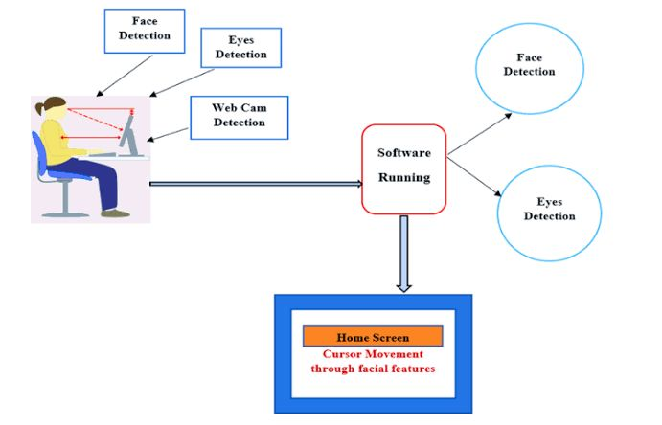
ARCHITECTURE DIAGRAM
❖

Slide 12
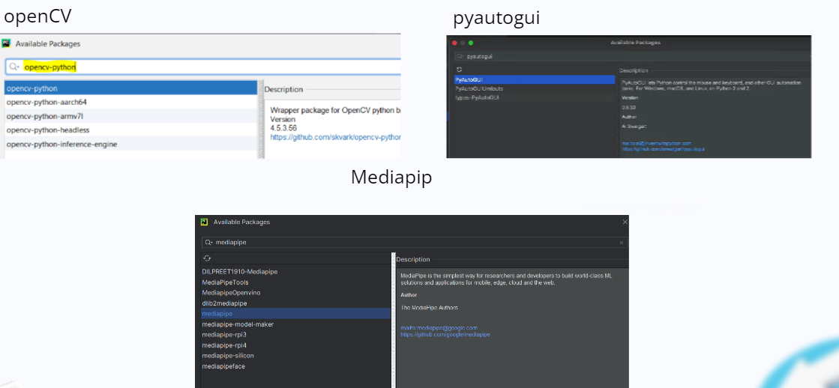
INSTALLATION OF PACKAGES

Slide 13
MODULE 1- ACCESSING CAMERA FROM USER
In order to access the camera we use the extension CV2, OpenCV has a function to read video, which is cv2. VideoCapture(). We can access our webcam using pass 0 in the function parameter. If you want to capture CCTV footage then we can pass the RTSP url in the function parameter, which is really useful for video analysis
Camera Integration: Investigate the feasibility of integrating a camera module into the visual mouse system alongside the eye-tracking sensors. This camera module could capture images or video of the user's surroundings, providing additional context for interpreting eye movements and enhancing the overall user experience.
Computer Vision Algorithms: Develop computer vision algorithms to analyze the images or video streams captured by the camera module. These algorithms could be used to detect objects or visual cues in the user's environment that may influence their eye movement patterns or interaction preferences.

Slide 14
MODULE 2 – FACE DETECTION
In order to detect the face the face we were using the extension named nediapipe Delight your customers with innovative machine learning features.MediaPipe contains everything that you need to customize and deploy to mobile (Android, iOs), web, desktop, edge devices, and loT, effortlessly.
Facial Feature Extraction: Utilize face detection algorithms to identify and locate the user's face within the camera's field of view. Extract key facial features such as the eyes, nose, and mouth to facilitate more precise eye-tracking and cursor control.
Gaze Direction Estimation: Use facial feature tracking to estimate the user's gaze direction based on the position and orientation of their eyes relative to the detected facial landmarks. This information can be combined with eye-tracking data to improve the accuracy of cursor movement prediction and interaction responsiveness.

Slide 15
MODULE 3 – FACIAL LANDMARK
The order of color is BGR (blue, green, red). The OpenCV function imwritel) that saves an image assumes that the order of colors is BGR, so it is saved as a correct image. When performing image processing with Pillow, you can convert ndarray to a PIL. Image object with Image.In our face we have 483 land marks!!
Landmark Detection: Implement algorithms to detect and localize facial landmarks, such as the eyes, nose, mouth, and other key facial features, in real-time. Utilize computer vision techniques, such as convolutional neural networks (CNNs) or shape-based models, to accurately identify and track these landmarks from captured images or video streams.
Landmark Detection: Implement algorithms to detect and localize facial landmarks, such as the eyes, nose, mouth, and other key facial features, in real-time. Utilize computer vision techniques, such as convolutional neural networks (CNNs) or shape-based models, to accurately identify and track these landmarks from captured images or video streams

Slide 16
MODULE 4 – EXTRACTION OF EYE AREA
Image Processing Techniques: Utilize image processing techniques, such as segmentation and filtering, to isolate and extract the region of interest corresponding to the eyes from the captured images or video frames. Apply algorithms to enhance contrast, reduce noise, and detect the boundaries of the eye area for accurate extraction.
Eye Movement Tracking: Track the movement of the eyes over time by continuously updating the position and characteristics of the extracted eye area. Monitor changes in pupil size, shape, and position to detect saccades, blinks, and other eye movements, providing valuable insights into the user's attention and cognitive state.
Eye Region Detection:Once the face is detected, identify the regions of the eyes. This can be done using specific models for eye detection, or by leveraging facial landmarks to locate the eye regions accurately.

Slide 17
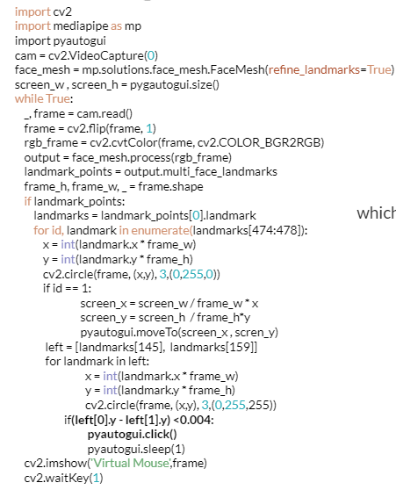
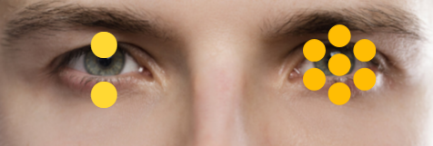
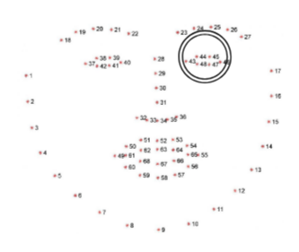
PROGRAM

Slide 18
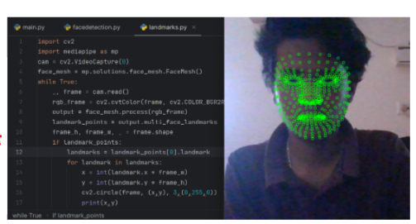
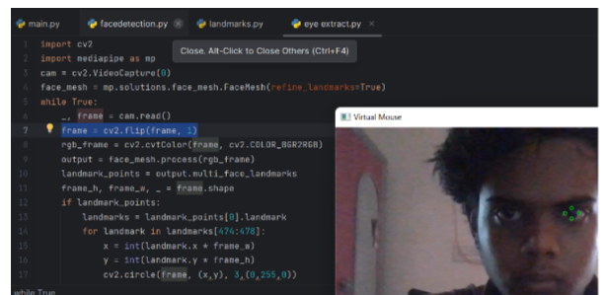
OUTPUT

Slide 19
RESULTS AND DISCUSSION
After successfully executing the virtual mouse using python for using the mouse virtually. we can minimize the usage of mouse and it will more helpful to physically challenged.
Furthermore, the virtual mouse has the potential to improve the overall efficiency and comfort of computer interaction for all users, regardless of ability. By enabling intuitive and natural control of the cursor through eye tracking, users can navigate digital interfaces more seamlessly and engage with content more effectively.

Slide 20
CONCLUSION
The basic objective is to develop a virtual mouse and keyboard using the concepts of hand gestures cognition and image processing which will ultimately move the mouse pointer according to the hand gestures, To similarly with the help of the gesture can use keyboard functions which will be defined as per the convenience of the user Reducing the cost of hardware.This paper is proposing a system to recognize the eyes hand gesture and replace the mouse and keyboard function. That includes the movement of the mouse cursor, the drag and click with the keyboard features like printing alphabets and other keyboard functions.

Slide 21
THANK YOU

